Slide 1



Slide 2



Course: Mastering Microsoft Azure
Lecture on:
Instructor: Siddhesh Prabhugaonkar

Slide 3
Introduction to Azure Backup

Slide 4
Learning Objectives: Introduction to Azure Backup
What is Azure Backup?
How does Azure Backup work?
Implement Azure Backup Centre
Demonstration: Backup Azure File Shares
Learning recap
Monitor and maintain Azure resources (10%–15%): Implement backup and recovery
Create a Recovery Services vault
Create an Azure Backup vault
Create and configure a backup policy
Perform backup and restore operations by using Azure Backup
Configure and interpret reports and alerts for backups

Slide 5


What Is Azure Backup?
Backup agents
Azure Backup Service
Built-in backup
Recovery Point Management
Resiliency and Availability
Azure Virtual Machines
Azure Managed Disks
Azure Files Shares
SQL Server in Azure VMs
SAP HANA databases in Azure VMs
Azure Database for PostgreSQL servers
Azure Blobs
On-premises files, folders and system state
Storage Management
Data Tiering
Multi-User Authorisation
Policy Management
Monitoring and Reporting
Multi-Factor Authentication
Access Control

Slide 6
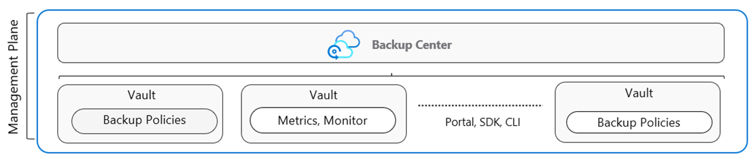
How Azure Backup Works (Vaults and Policies)
Vaults store backup copies, recovery points and backup policies
Two types of vaults: Backup vault and Recovery Service vault
Backup Policies define the data source, storage vault and backup schedule
The Backup Center provides a single unified management experience (next slide)

Slide 7
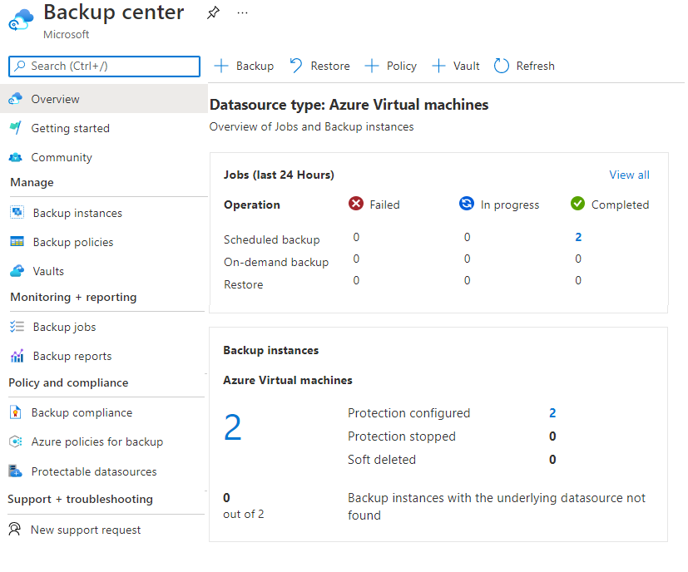
Implement Azure Backup Center
Single pane of glass to manage backups across a large and distributed Azure environment
Datasource-centric management focused on what you are backing up
Connected experiences with native integrations that enables management at scale

Slide 8
Backup Azure File Shares: Demonstration
Configure a storage account with file share
Create a Recovery Services vault
Configure file share backup
Verify and restore (optional) the backup

Slide 9
Configure Virtual Machine Backups

Slide 10
Learning Objectives: Configure Virtual Machine Backups Introduction
Explore options to protect virtual machine data
​Create virtual machine snapshots in Azure Backup
Setup Recovery Services Vault backup options
Backup Virtual Machines
Restore Virtual Machines
Virtual Machine Backups: Demonstration
Manage soft delete (optional)
Implement Azure Site Recovery
Learning recap
Monitor and maintain Azure resources (10%–15%): Implement backup and recovery
Perform backup and restore operations by using Azure Backup
Configure Azure Site Recovery for Azure resources
Perform a failover to a secondary region by using Site Recovery
Configure and interpret reports and alerts for backups

Slide 11
Explore options to protect virtual machine data
Snapshots
Azure Backup
Azure Site Recovery
Managed snapshots provide a quick and simple option for backing up VMs that use Managed Disks
Azure Backup supports application-consistent backups for both Windows and Linux VMs
Azure Site Recovery protects your VMs from a major disaster scenario when a whole region experiences an outage

Slide 12
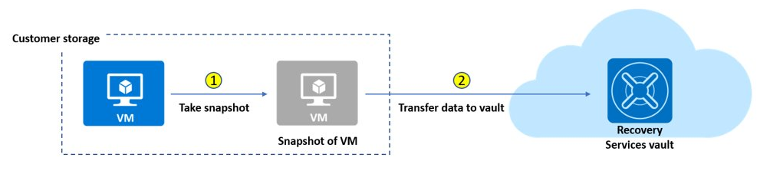
Create Virtual Machine Snapshots in Azure Backup
Use snapshots taken as part of a backup job
Reduces recovery wait times – do not wait for data transfer to the vault to finish
Configure Instant Restore retention (standard or enhanced)

Slide 13
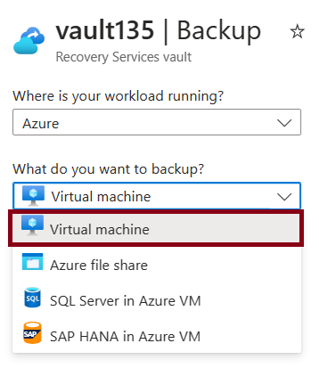
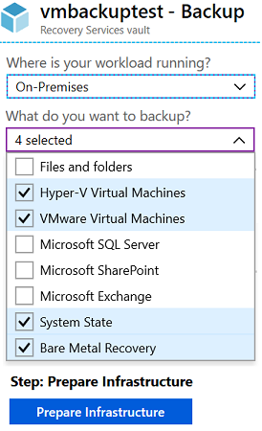
Set Up Azure Recovery Services Vault Backup Options
Multiple servers can be protected using the same Recovery Services vault
Azure Workloads
On-Premises Workloads

Slide 14
Backup Virtual Machines
Create a recovery
services vault
Use the Portal to
define the backup
Backup the
virtual machine
Use a Recovery Services Vault in the region where you are performing your Virtual Machine backups, and choose a replication strategy for Vault
Take snapshots (recovery points) of your data at defined intervals. These snapshots are stored in recovery services vaults
For the Backup extension to work, the Azure VM Agent must be installed on the Azure virtual machine

Slide 15
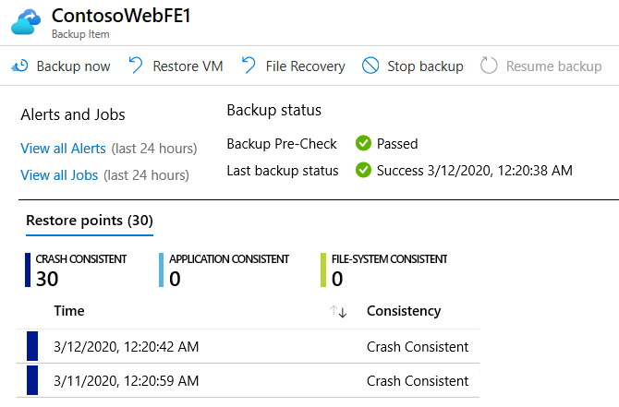
Restore Virtual Machines
Once you trigger the restore operation, the Backup service creates a job for tracking the restore operation
The Backup service also creates and temporarily displays notifications, so you monitor how the backup is proceeding

Slide 16
Virtual Machine Backups: Demonstration
Create a backup for virtual machines
Configure and review the backup policy

Slide 17
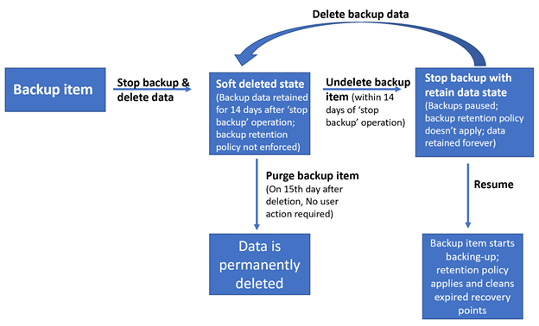
Manage Soft Delete
Backup data is retained for 14 additional days*
Recover soft deleted backup items using an ‘Undelete’ operation
Also available for storage account containers and file shares
Natively built-in for all the recovery
services vaults

Slide 18
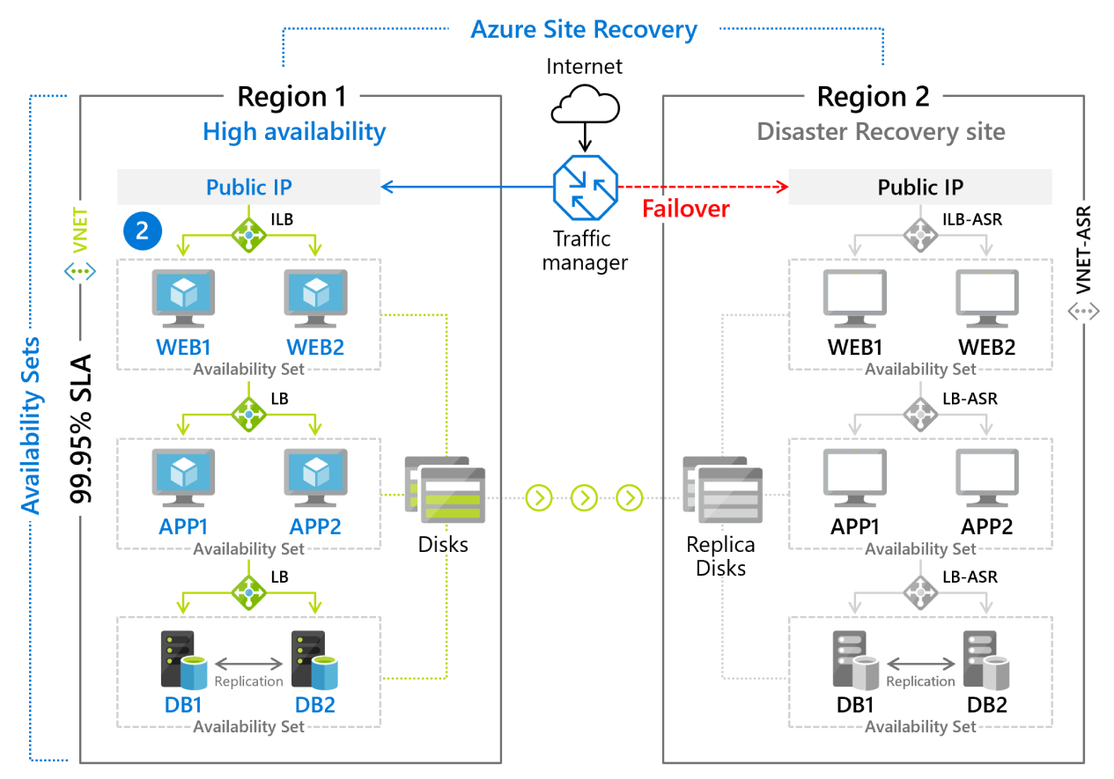
Implement Azure Site Recovery
Manages the orchestration of disaster recovery
Replicates workloads continuously from a primary location or region to a secondary location
Failover to shift to the secondary location; failback to return to the primary location

Slide 19
LAB: Implement Data Protection

Slide 20
Lab 10: Implement Data Protection
Job Skills
Task 1: Use a template to provision an infrastructure
Task 2: Create and configure a Recovery Services vault
Task 3: Configure Azure virtual machine-level backup
Task 4: Monitor Azure Backup
Task 5: Enable virtual machine replication
In this lab, you will learn about backup and recovery of Azure virtual machines
You will learn to create a Recovery Service vault and a backup policy for Azure virtual machines
You will learn about disaster recovery with Azure Site Recovery for virtual machines
Notes:
Lab 10 - https://microsoftlearning.github.io/AZ-104-MicrosoftAzureAdministrator/Instructions/Labs/LAB_10-Implement_Data_Protection.html

Slide 21




Lab 10: Architecture Diagram
Region 1
Region 2
az104-rg-region1
az104-rg-region2
Task 1
Task 5
az104-10-vm0
replication
az104-rsv-region2
Task 2
az104-rsv-region1
Task 4
Task 3
Azure Backup
Monitor

Slide 22
Thank You!

